Slide 1

Spotify Overview of Top 10 Tracks from Global Charts Dashboard Link –> Tableau Data Preparation code –> GitHub
Author: Lakshman Kolasani

Slide 2
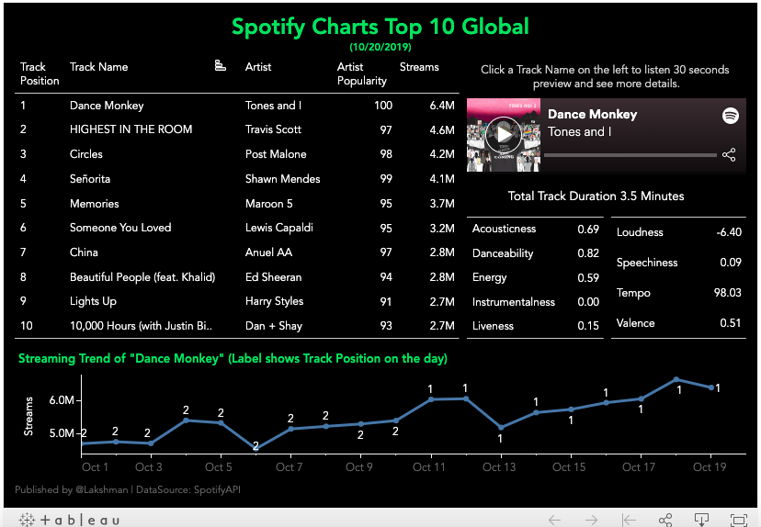
Dashboard View

Slide 3
Notes
Target audience for this Dashboard are assumed as Artists or Record Labels who would like to keep a tab on the top trending tracks and their audio features.
The Interactive Dashboard shows list of top 10 Tracks, their audio features, 30 seconds song previews, and their trends over past 3 weeks.
The Dashboard was designed with Data mined using Spotipy, a lightweight Python library for Spotify Web API, on 10/20/2019.

